Slide 1


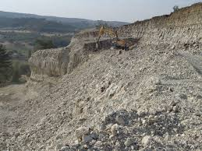
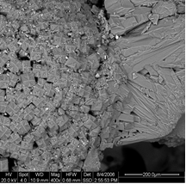
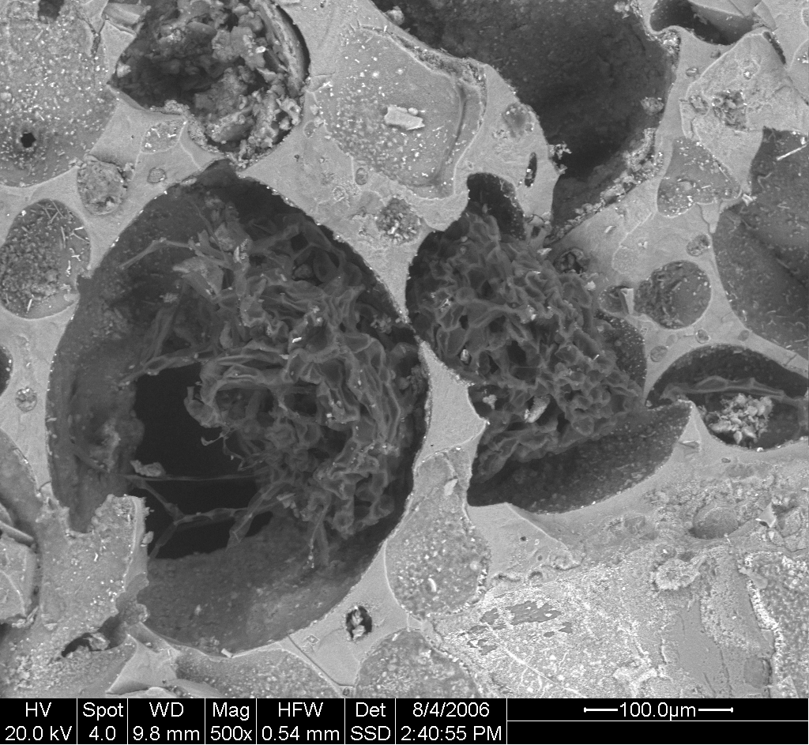
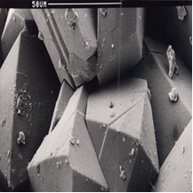
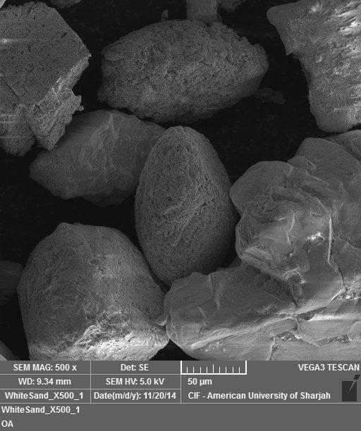
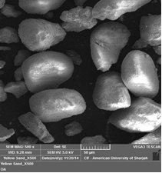
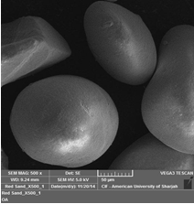
Removal of Pb(II) from Wastewaters by Zeolites and Sands: Correlation of X-ray Fluorescence Data and Scanning Electron Microscope Images to Batch Removal Efficiency
Fawwaz Jumean*, Lucia Pappalardo*, Hani Khoury**
*Department of Biology, Chemistry and Environmental Sciences, AUS, Sharjah, UAE
**Department of Geology, The University of Jordan, Amman, Jordan
The Third International Conference on Water, Energy and Environment (ICWEE) -
AUS | March 24–26, 2015
Abstract
Results
Chemical compositions of natural zeolites, porcelanite and sands were determined by X-ray fluorescence and correlated with their Pb(II) removal efficiencies. The effect of Pb(II) concentration and zeolite dosage was investigated. Kaolinite, silica and alumina were studied for comparison. Hannon zeolite was most efficient, with a removal capacity of 77 mg Pb(II)/g zeolite from a 300 ppm Pb(II) solution. Efficiencies followed the order: Hannon> Mikawir> Aritain and that for porcelanite was close to that for Hannon. Zeolites were significantly more efficient than sands, kaolinite, silica and alumina. Adsorbents with intermediate (2.70-2.93) nSi/nAl ratios were most efficient. Scanning electron microscope micrographs were correlated with efficiencies. [1]
Removal efficiencies, in mg Pb(II)/g adsorbent, were: 76.9, 52.7 and 42.1 for Hannon, Mikawer and Aritain zeolites, respectively; 58.2 for porcelanite; 29.7, 11.0 and 8.5 for yellow, red and white sand, respectively; 7.2, 3.3 and 1.3 for kaolinite, silica and alumina, respectively.
The chemical composition analysis as determined by the X-ray fluorescence (XRF) data indicates that adsorbents with intermediate molar ratios of Si/Al, in the range 2.70-2.93, are most efficient in the Pb(II) removal from aqueous solutions.
The morphology analysis as determined by the Scanning electron microscope (SEM) images of adsorbents suggests that a combination of factors, including shapes and sizes of crystals, channels in zeolites and pores in porcelanite, appear to favor removal of Pb(II). SEM data suggest then that morphology, in addition to chemical composition, plays a key role in the removal.
Introduction
Pb(II) in the environment has a high level of toxicity and poses a serious hazard to human and animal health. Effluents from battery and electronics factories augment the concentration of Pb(II) in reservoirs and wastewaters. Column filtration and batch equilibrium by low cost adsorbents are the most common methods used in removing Pb(II) and other toxic heavy metals from wastewaters. It has been shown that UAE sands are efficient adsorbents for the removal and recovery of Pb(II) and other heavy metals from aqueous solutions [2, 3], and for the removal and speciation of Cr(III) and Cr(VI) [4]. In this work removal efficiencies of Pb(II) from aqueous solutions by zeolites, sands, porcelanite, and commercial kaolinite, alumina and silica are compared. Also the removal efficiencies are correlated to the chemical composition and the morphology of the adsorbents.
SEM micrographs of a. Mikawir zeolite b. Aritain zeolite c. Hannon zeolite. d. White sand. e. Yellow sand. f. Red sand.
Objectives
a
b
c
To determine the removal efficiencies of lead from synthetic wastewater solutions by low cost adsorbents.
To determine the chemical compositions of the low cost adsorbents by X-ray fluorescence (XRF).
To determine the morphology of the low cost adsorbents by Scanning electron microscopy (SEM).
To correlate the Pb(II) removal efficiencies of the low cost adsorbents to their chemical composition and morphology.
Methods and Materials
d
e
f
Adsorbents
White, yellow and red sand samples were collected from several locations in the UAE. Mikawer, Aritain and Hannon zeolites were obtained from areas with the same names in Jordan.
Instrumentation
Lead concentrations were determined using a Varian Liberty axial sequential inductively coupled plasma-atomic emission spectrometer “ICP-AES”. XRF images and spectra were obtained using a Horiba, XGT-7200V X-ray analytical microscope with silicon drift detector (SDD). SEM micrographs on sands were obtained using a high resolution TESCAN Vega 3-LMU, equipped with a 4-lens electron optics system. Micrographs on platinum coated samples of zeolites and porcelanite were obtained using an FEI-INSPECT-F50.
Batch studies
Batch equilibration studies were performed using 0.100 dm³ Pb(II) solutions on a known mass of adsorbent equilibrated at 25.0ºC for 2 h at 200 rpm.
Conclusions
Zeolites and porcelanite are more efficient than sands or other common adsorbents in removing Pb(II) from wastewater solutions.
Molar ratios of Si/Al in the adsorbents can be correlated with removal efficiencies. Adsorbents with an intermediate molar ratios of Si/Al, in the range 2.70-2.93, are most efficient in the Pb(II) removal from aqueous solutions.
Morphology of the adsorbents shows that a combination of factors, including shapes and sizes of crystals, channels in zeolites and pores in porcelanite, favor the removal of Pb(II).
Pb(II) removal efficiency as a function of adsorbent dosage. Volume of solution = 0.100 dm³. Initial [Pb(II)]=300 ppm. T=25.0ºC. Equilibration time = 2 h. (Symbols: H=Hannon, P=porcelanite, M=Mikawer, A=Aritain, Y=yellow sand, W=white sand, R=red sand, K=kaolinite, S=silica, Al=alumina.)
References
Jumean, F., Pappalardo, L. and Khoury, H. (2015) Removal of Pb(II) from Aqueous Solutions by Zeolites, Porcelanite and Sands: Correlation of Morphology and Chemical Composition to Batch Removal Efficiency. American Journal of Analytical Chemistry, (in press).
Pappalardo, L., Jumean, F. and Abdo, N. (2010) Removal of Cadmium, Copper, Lead and Nickel from Aqueous Solution by White, Yellow and Red United Arab Emirates Sand. American Journal of Environmental Sciences, 6(1), 41-44.
Pappalardo, L., Jumean, F. and Abdo, N. (2011) Removal and Recovery of Lead from Aqueous Solution by Low Cost Media. American Journal of Environmental Sciences, 7(2), 141-144.
Khamis, M., Jumean, F. and Abdo, N. (2009) Speciation and Removal of Chromium from Aqueous Solution by White, Yellow and Red UAE Sand. Journal of Hazardous Materials, 169, 948-952.

